Slide 1



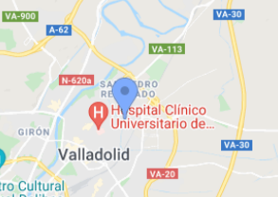


PLANT POWER MINI LAUNCH
Organized by ITACyL and University of Valladolid
HOSTED by University of Valladolid
BUILDING INNOVATION AND KNOWLEDGE FOR A BETTER FOOD NUTRITION IN PLANT BASED PRODUCTS
Plant-based nutrition is gaining interest among consumers and in clinical practice due to its role in preventing and managing chronic diseases.
However, to meet evolving health needs, there’s a growing demand for innovation—particularly in addressing nutrient gaps like B12, iron, and protein quality. Educating consumers, training clinicians, and developing fortified foods, supplements, and culturally relevant options are critical. Bridging science with real-world applications will drive smarter, more accessible plant-based solutions for consumers.
WHO SHOULD ATTEND.
4TH July 2025
Nutritionists and Dietitians
Healthcare Professionals (Doctors, Nurses, Clinicians)
Food Scientists and Product Developers
Public Health Officials and Policy Makers
Researchers and Academics
Startups and Industry Leaders in Plant-Based Foods
Students in Nutrition, Medicine, or Food Technology
For further information contact: DANIEL ANTONIO DE LUIS ROMAN danielantonio.luis@uva.es; DANIEL RICO BARGUES daniel.rico@uva.es; JUAN JOSE LOPEZ GOMEZ juanjose.lopez.gomez@uva.es
www.plantpowerproject.eu

Slide 2







www.plantpowerproject.eu
PLANT POWER MINI LAUNCH
Hosted by University of Valladolid and ITACyL

Slide 3







MOVILIDAD
INCLUSIÓN
INNOVACIÓN

Slide 4
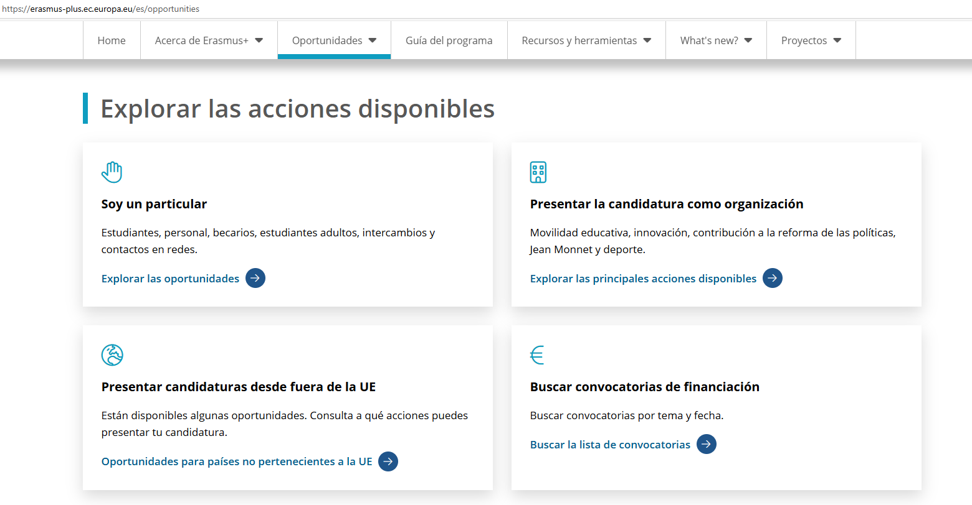

Slide 5

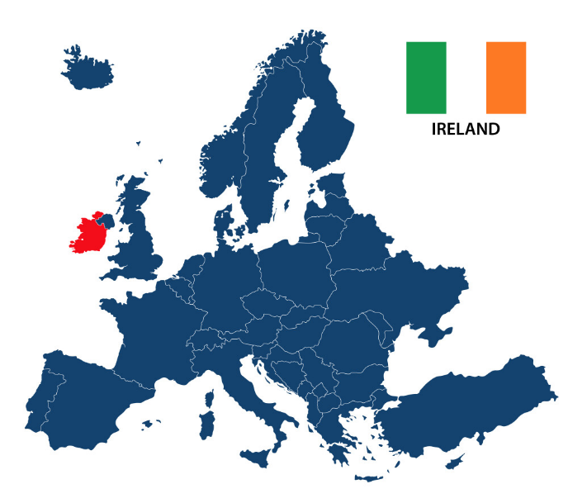

Slide 6



Reformulación de las competencias de los profesionales del sector de los cuidados dedicados hacia las personas mayores
DIGITALIZACIÓN

Slide 7
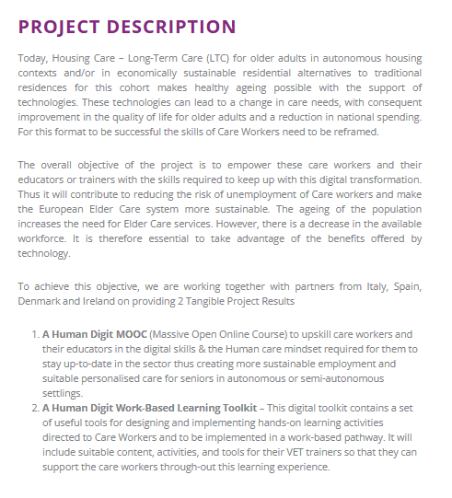

Slide 8

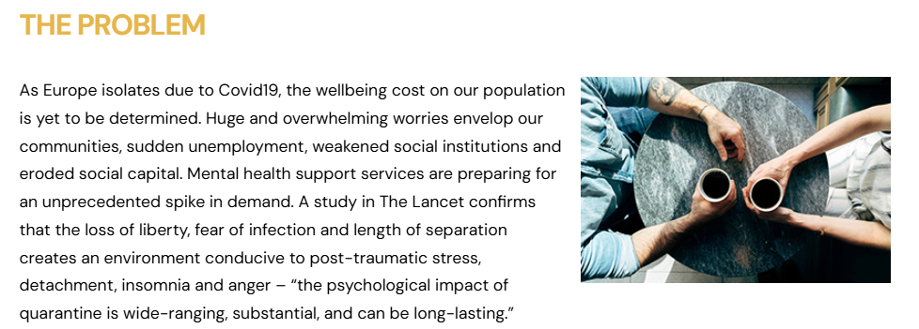

Slide 9


Slide 10



Slide 11
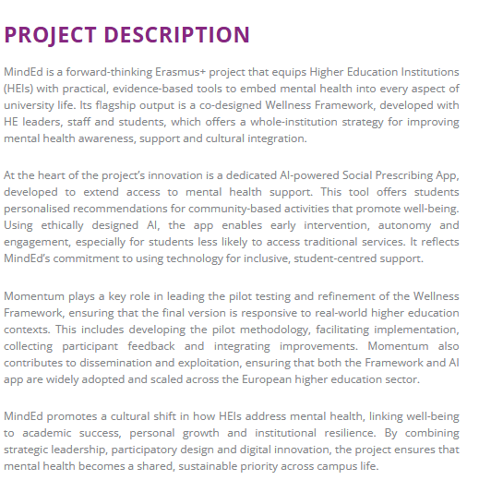

Slide 12



Slide 13
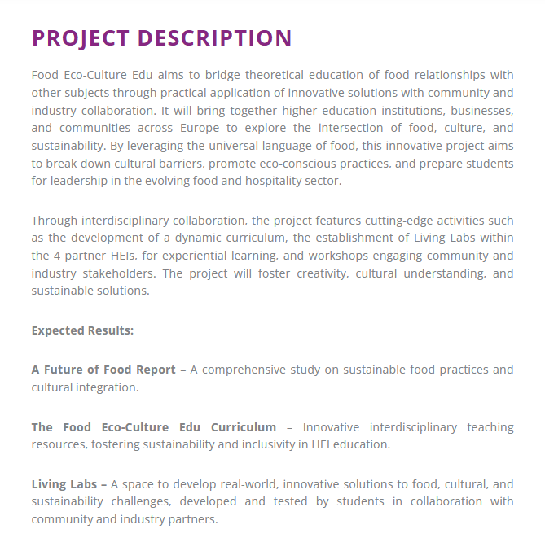

Slide 14


Slide 15


TEAM

Slide 16
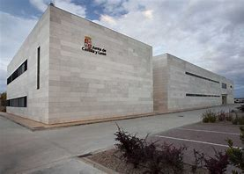


INSTITUTO TECNOLÓGICO AGRARIO DE CASTILLA Y LEÓN
UNIVERSIDAD DE VALLADOLID-FACULTAD DE MEDICINA

Slide 17

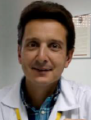

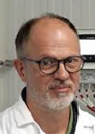


Slide 18



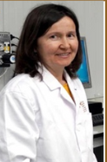

Slide 19
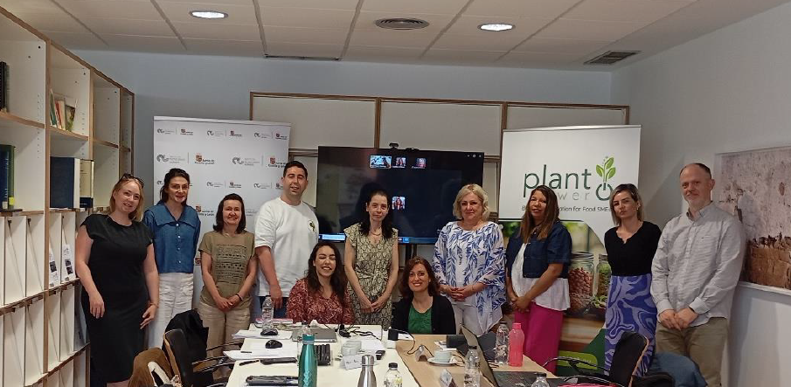

Slide 20
Plant Power is a project created to contribute to the transformation of Europe’s food sector through innovation and the creation of a replicable learning model.
The goal of this project is to provide small and medium-sized food enterprises (SMEs), agri-food technicians, and policymakers with the necessary skills, resources, facilities, and strategies to support Europe’s food sector in embracing heathy plant-based products through innovation, active learning and sustainability.

Slide 21

Planning and implementation

Slide 22
1
2
PROJECT MANAGEMENT

Slide 23
1
2
Inspiration & Awareness Creation - The Inspirational Good Practice Guide to
Plant-Based Food Product Development
PROJECT MANAGEMENT

Slide 24
1
2
3
Inspiration & Awareness Creation - The Inspirational Good Practice Guide to
Plant-Based Food Product Development
Developing Innovative Plant-Based Food Products - Open Education
Resources (for VET)
PROJECT MANAGEMENT

Slide 25
1
2
3
Inspiration & Awareness Creation - The Inspirational Good Practice Guide to
Plant-Based Food Product Development
Developing Innovative Plant-Based Food Products - Open Education
Resources (for VET)
PROJECT MANAGEMENT
4
Innovative Plant-Based Food Products Development Education - Online
Course (for SMEs)

Slide 26
1
2
3
Inspiration & Awareness Creation - The Inspirational Good Practice Guide to
Plant-Based Food Product Development
Developing Innovative Plant-Based Food Products - Open Education
Resources (for VET)
PROJECT MANAGEMENT
4
5
Innovative Plant-Based Food Products Development Education - Online
Course (for SMEs)
Plant Power Impact and Dissemination

Slide 27


La Guía de Buenas Prácticas de Plant Power está meticulosamente desarrollada para proporcionar a los desarrolladores de alimentos, educadores y pymes información valiosa y prácticas innovadoras en el ámbito de los productos alimenticios a base de plantas.
El marco de investigación en el que se basa esta guía es una combinación de Educación Basada en Competencias (CBE) y el Método de Investigación Narrativa por Historias (StM).
Estas metodologías fueron seleccionadas para garantizar que la guía no solo sea educativa, sino también atractiva, ofreciendo conocimientos prácticos que se pueden aplicar a escenarios del mundo real.

Slide 28
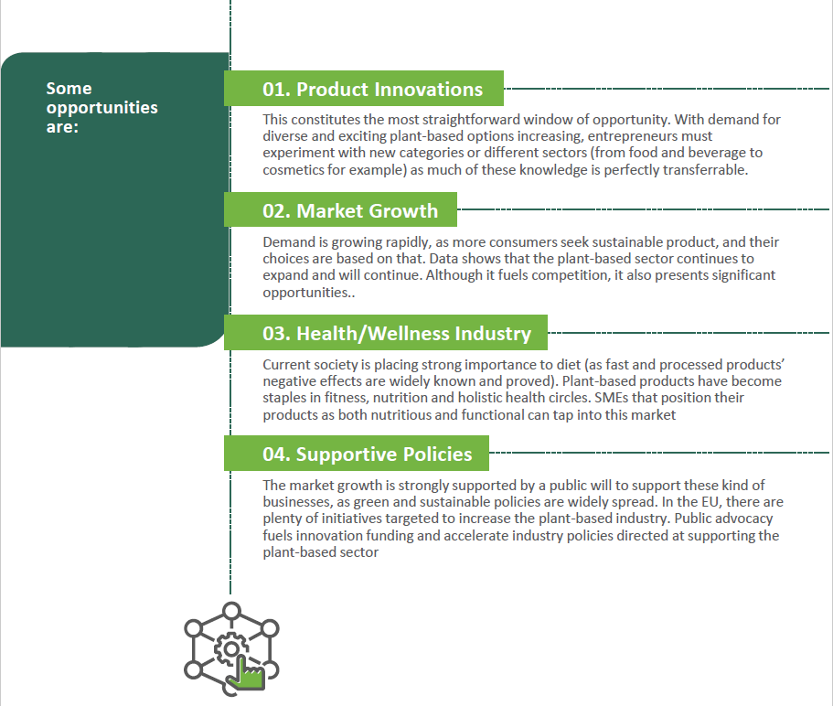

Slide 29
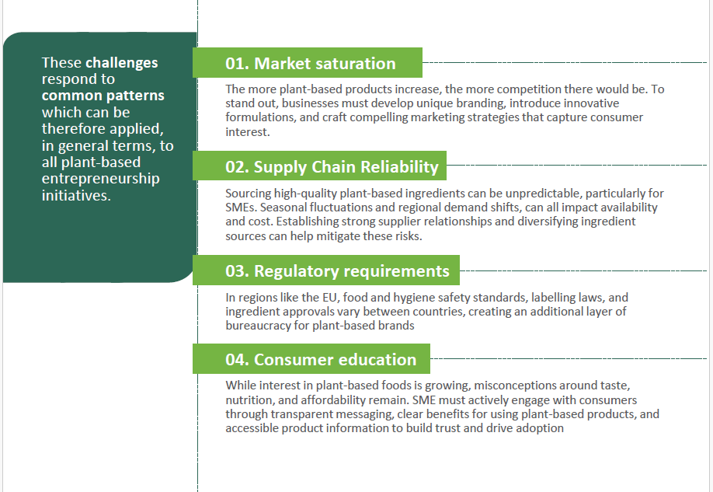

Slide 30
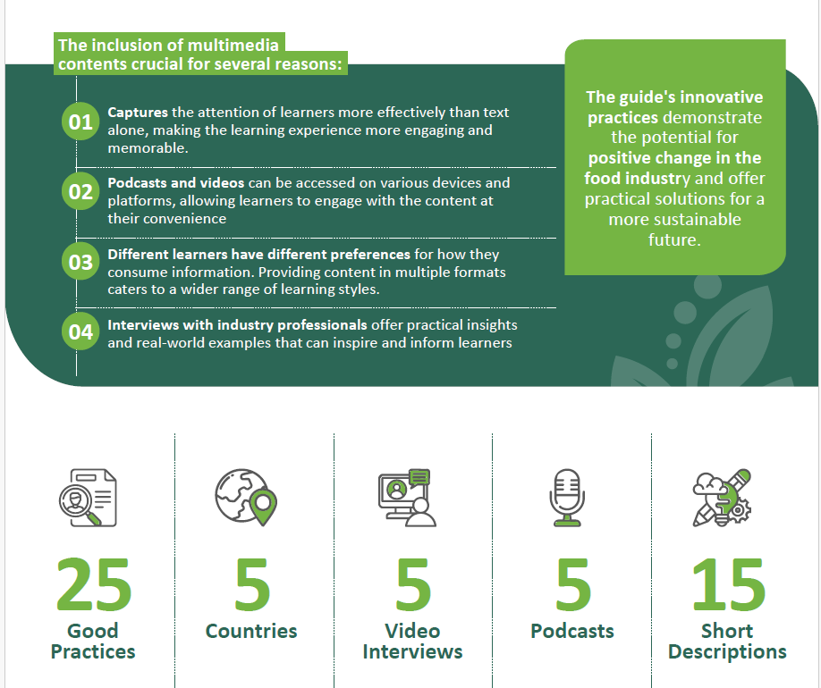

Slide 31
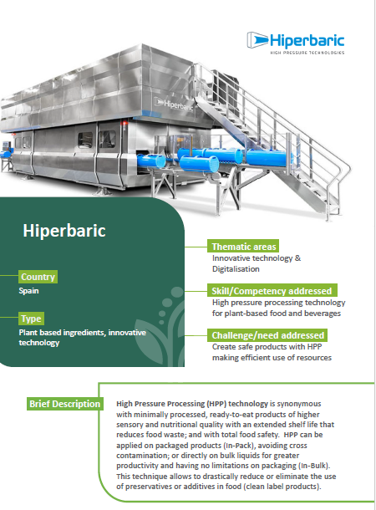
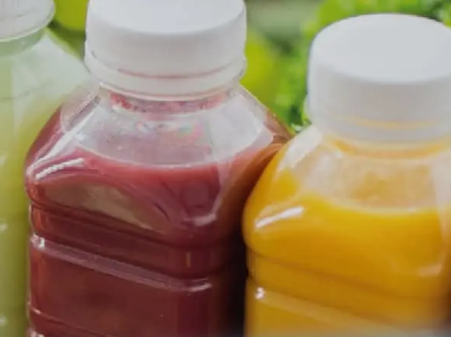

Slide 32
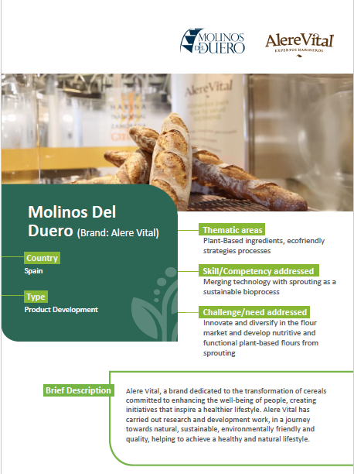
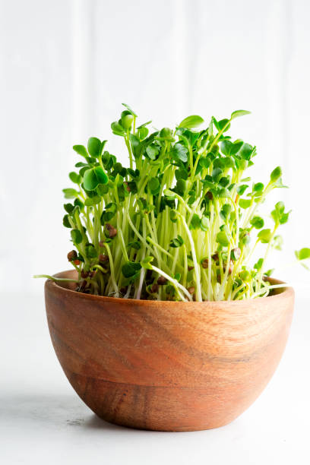

Slide 33
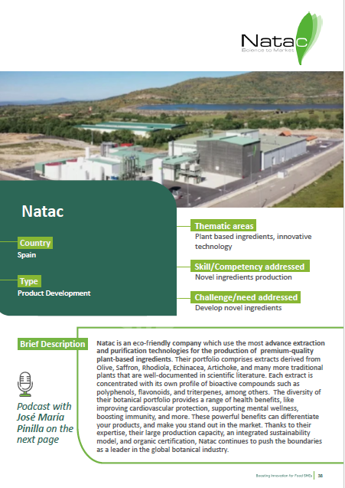

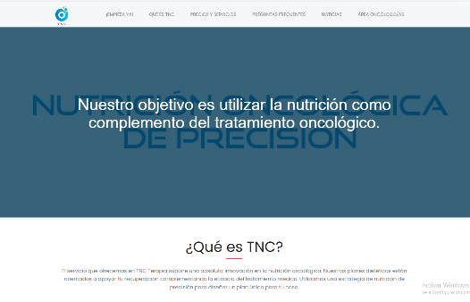

Slide 34
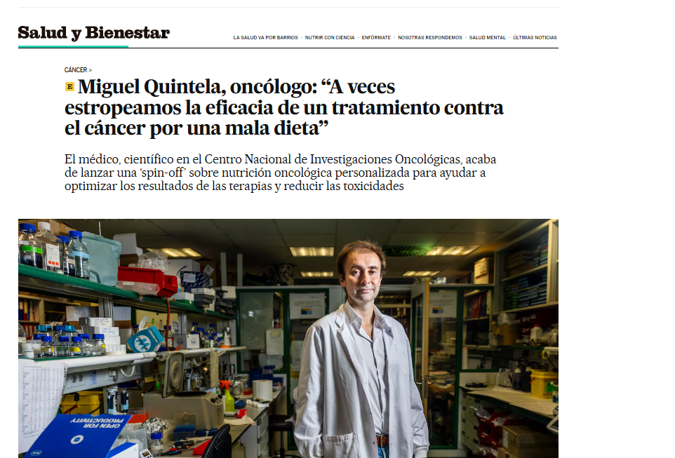

Slide 35
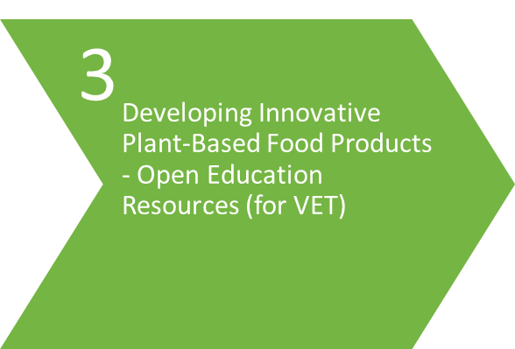
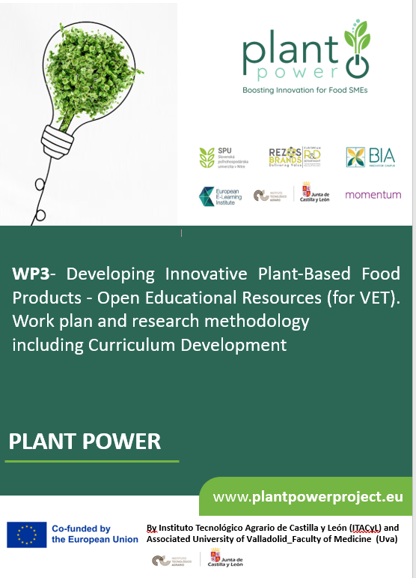

Slide 36




